Slide 1
Chapter 1 Computer System Overview
Operating Systems: Internals and Design Principles
Ninth Edition
By William Stallings
Notes:
“Operating Systems: Internal and Design Principles”, 9/e, by William Stallings, Chapter 1 “Computer System Overview”.

Slide 2
Operating System
Exploits the hardware resources of one or more processors
Provides a set of services to system users
Manages secondary memory and I/O devices
Notes:
An operating system (OS) exploits the hardware resources of one or more processors to provide a set of services to system users. The OS also manages secondary memory and I/O (input/output) devices on behalf of its users. Accordingly, it is important to have some understanding of the underlying computer system hardware before we begin our examination of operating systems.
This chapter provides an overview of computer system hardware. In most areas,
the survey is brief, as it is assumed that the reader is familiar with this subject. However,
several areas are covered in some detail because of their importance to topics
covered later in the book. Further topics are covered in Appendix C. For a more
detailed treatment, see [STAL16a].

Slide 3
Basic Elements
Processor
Main Memory
I/O Modules
System Bus
Notes:
At a top level, a computer consists of processor, memory, and I/O components, with one or more modules of each type. These components are interconnected in some fashion to achieve the main function of the computer, which is to execute programs. Thus, there are four main structural elements:
Processor
I/O Modules
Main Memory
System Bus

Slide 4
Processor
Controls the operation of the computer
Performs the data processing functions
Referred to as the Central Processing Unit (CPU)
Notes:
Processor : Controls the operation of the computer and performs its data processing functions. When there is only one processor, it is often referred to as the central processing unit (CPU).

Slide 5
Main Memory
Stores data and programs
Typically volatile
Contents of the memory is lost when the computer is shut down
Referred to as real memory or primary memory
Notes:
Main memory : Stores data and programs. This memory is typically volatile; that is, when the computer is shut down, the contents of the memory are lost. In contrast, the contents of disk memory are retained even when the computer system is shut down. Main memory is also referred to as real memory or primary memory.

Slide 6
I/O Modules
Move data between the computer and its external environment
Secondary memory devices (e.g. disks)
Communications equipment
Terminals
Notes:
I/O modules : Move data between the computer and its external environment. The external environment consists of a variety of devices, including secondary
memory devices (e.g., disks), communications equipment, and terminals.

Slide 7
System Bus
Provides for communication among processors, main memory, and I/O modules
Notes:
System bus : Provides for communication among processors, main memory, and I/O modules.

Slide 8
Processor Organization
Processor Requirements:
Fetch instruction
The processor reads an instruction from memory (register, cache, main memory)
Interpret instruction
The instruction is decoded to determine what action is required
Fetch data
The execution of an instruction may require reading data from memory or an I/O module
Process data
The execution of an instruction may require performing some arithmetic or logical operation on data
Write data
The results of an execution may require writing data to memory or an I/O module
To get this done, the processor needs some fast, responsive type of memory where data and instructions can be temporary stored while an instruction is executed A.K.A → REGISTERS

Slide 9
Notes:
Figure 1.1 depicts these top-level components. One of the processor’s functions is to exchange data with memory. For this purpose, it typically makes use of two internal (to the processor) registers: a memory address register (MAR), which specifies the address in memory for the next read or write; and a memory buffer register (MBR), which contains the data to be written into memory or which receives the data read from memory. Similarly, an I/O address register (I/OAR) specifies a particular I/O device. An I/O buffer register (I/OBR) is used for the exchange of data between an I/O module and the processor.
A memory module consists of a set of locations, defined by sequentially numbered addresses. Each location contains a bit pattern that can be interpreted as either an instruction or data. An I/O module transfers data from external devices to processor and memory, and vice versa. It contains internal buffers for temporarily holding data until they can be sent on.

Slide 10
Four registers are essential to instruction execution:
Program counter (PC)
Contains the address of an instruction to be fetched
Instruction register (IR)
Contains the instruction most recently fetched
Memory address register (MAR)
Contains the address of a location in memory
Memory buffer register (MBR)
Contains a word of data to be written to memory or the word most recently read

Slide 11
Control and Status Registers
Not all processors have
MAR and MAB
Some form of buffering mechanism IS REQUIRED (R,W)
Processor updates the PC after each INST is fetch
PC always points to the next one (INST) to be executed
Fetched instruction will be loaded into the IR
@ the IR → opcode and operands will be analyzed
MAR, connect directly to the ADDRESS-BUS
MBR, connects directly to the DATA-BUS
User-Visible registers interchange data with it
ALL → PC, IR, MAR, MBR → used for movement of data between the Processor and Memory
ALU → Data → MBR → User Visible Registers
ALU boundary → additional registers, work as input and output registers

Slide 12
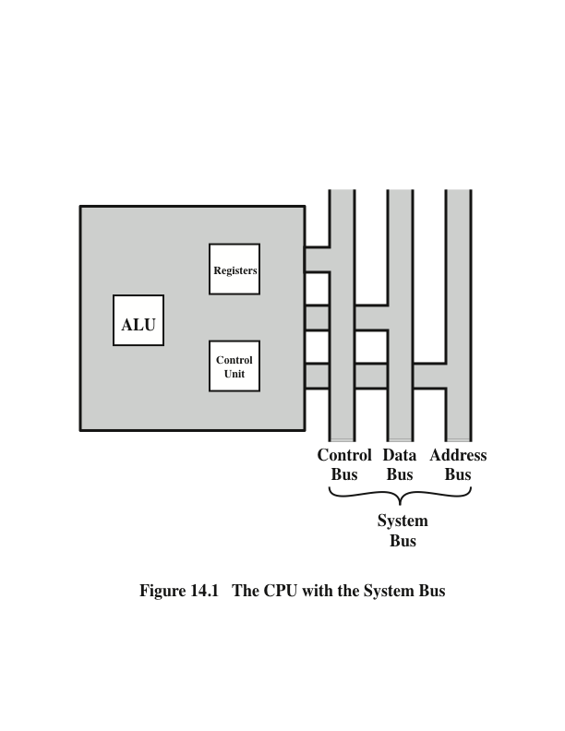

Slide 13

MORE IN A SEC, WE WILL COMEBACK TO THIS LATTER

Slide 14
Microprocessor
Invention that brought about desktop and handheld computing
Contains a processor on a single chip
Fastest general purpose processors
Multiprocessors
Each chip (socket) contains multiple processors (cores)
Notes:
The hardware revolution that brought about desktop and handheld computing was the invention of the microprocessor, which contained a processor on a single chip. Though originally much slower than multichip processors, microprocessors have continually evolved to the point that they are now much faster for most computations due to the physics involved in moving information around in sub-nanosecond timeframes.
Not only have microprocessors become the fastest general purpose processors available, they are now multiprocessors; each chip (called a socket) contains multiple processors (called cores), each with multiple levels of large memory caches, and multiple logical processors sharing the execution units of each core. As of 2010, it is not unusual for even a laptop to have 2 or 4 cores, each with 2 hardware threads, for a total of 4 or 8 logical processors.

Slide 15
Graphical Processing Units (GPU’s)
Provide efficient computation on arrays of data using Single-Instruction Multiple Data (SIMD) techniques pioneered in supercomputers
No longer used just for rendering advanced graphics
Also used for general numerical processing
Physics simulations for games
Computations on large spreadsheets
Notes:
Although processors provide very good performance for most forms of computing, there is increasing demand for numerical computation. Graphical Processing Units (GPUs) provide efficient computation on arrays of data using Single-Instruction Multiple Data (SIMD) techniques pioneered in supercomputers. GPUs are no longer used just for rendering advanced graphics, but they are also used for general numerical processing, such as physics simulations for games or computations on large spreadsheets. Simultaneously, the CPUs themselves are gaining the capability of operating on arrays of data—with increasingly powerful vector units integrated into the processor architecture of the x86 and AMD64 families.
Processors and GPUs are not the end of the computational story for the modern PC.

Slide 16
Digital Signal Processors (DSPs)
Deal with streaming signals such as audio or video
Used to be embedded in I/O devices like modems
Are now becoming first-class computational devices, especially in handhelds
Encoding/decoding speech and video (codecs)
Provide support for encryption and security
Notes:
Digital Signal Processors (DSPs) are also present, for dealing with streaming signals—such as audio or video. DSPs used to be embedded in I/O devices, like modems, but they are now becoming first-class computational devices, especially in handhelds. Other specialized computational devices (fixed function units) co-exist with the CPU to support other standard computations, such as encoding/decoding speech and video (codecs), or providing support for encryption and security.

Slide 17
System on a Chip (SoC)
To satisfy the requirements of handheld devices, the classic microprocessor is giving way to the SoC
Other components of the system, such as DSPs, GPUs, I/O devices (such as codecs and radios) and main memory, in addition to the CPUs and caches, are on the same chip
Notes:
To satisfy the requirements of handheld devices, the classic microprocessor is giving way to the System on a Chip (SoC), where not just the CPUs and caches are on the same chip, but also many of the other components of the system, such as DSPs, GPUs, I/O devices (such as radios and codecs), and main memory.

Slide 18
Instruction Execution
A program consists of a set of instructions stored in memory
Processor reads (fetches) instructions from memory
Processor executes each instruction
Two steps
Notes:
A program to be executed by a processor consists of a set of instructions stored in memory. In its simplest form, instruction processing consists of two steps: The processor reads ( fetches ) instructions from memory one at a time and executes each instruction. Program execution consists of repeating the process of instruction fetch and instruction execution. Instruction execution may involve several operations and depends on the nature of the instruction.

Slide 19
Notes:
The processing required for a single instruction is called an instruction cycle. Using a simplified two-step description, the instruction cycle is depicted in Figure 1.2 . The two steps are referred to as the fetch stage and the execute stage. Program execution halts only if the processor is turned off, some sort of unrecoverable error occurs, or a program instruction that halts the processor is encountered.

Slide 20
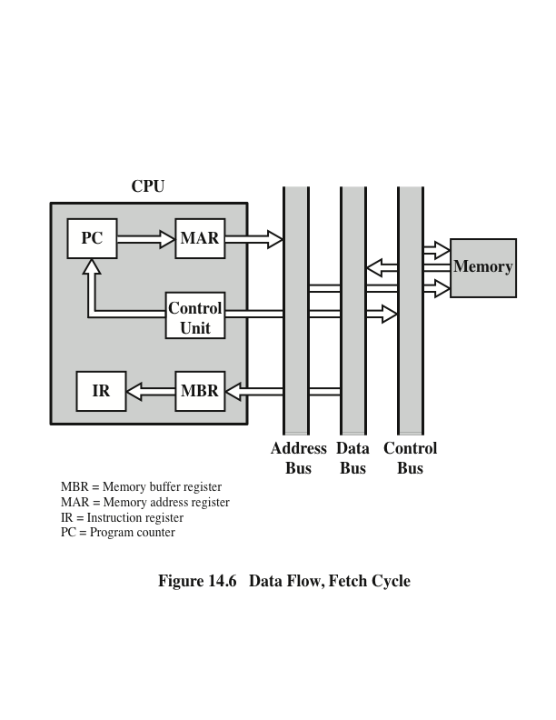
Data Flow, Fetch Cycle
Pc contains address of next instruction
This address is moved to the MAR and placed on the address BUS
The control unit requests a memory read
The result is placed on the data bus AND copied into the MBR
From the MBR goes to the IR
Meanwhile PC is incremented by 1

Slide 21
Instruction Fetch and Execute
The processor fetches an instruction from memory
Typically the program counter (PC) holds the address of the next instruction to be fetched
PC is incremented after each fetch
Notes:
At the beginning of each instruction cycle, the processor fetches an instruction from memory. Typically, the program counter (PC) holds the address of the next instruction to be fetched. Unless instructed otherwise, the processor always increments the PC after each instruction fetch so that it will fetch the next instruction in sequence (i.e., the instruction located at the next higher memory address).
For example, consider a simplified computer in which each instruction occupies one
16-bit word of memory. Assume that the program counter is set to location 300.
The processor will next fetch the instruction at location 300. On succeeding instruction
cycles, it will fetch instructions from locations 301, 302, 303, and so on. This
sequence may be altered, as explained subsequently.

Slide 22
Instruction Register (IR)
Fetched instruction is loaded into Instruction Register (IR)
Processor interprets the instruction and performs required action:
Processor-memory
Processor-I/O
Data processing
Control
Notes:
The fetched instruction is loaded into the instruction register (IR). The instruction contains bits that specify the action the processor is to take. The processor interprets the instruction and performs the required action. In general, these actions fall into four categories:
• Processor-memory: Data may be transferred from processor to memory or from memory to processor.
• Processor-I/O: Data may be transferred to or from a peripheral device by transferring between the processor and an I/O module.
• Data processing: The processor may perform some arithmetic or logic operation on data.
• Control: An instruction may specify that the sequence of execution be altered. For example, the processor may fetch an instruction from location 149, which
specifies that the next instruction be from location 182. The processor sets the
program counter to 182. Thus, on the next fetch stage, the instruction will be
fetched from location 182 rather than 150.
An instruction’s execution may involve a combination of these actions.

Slide 23
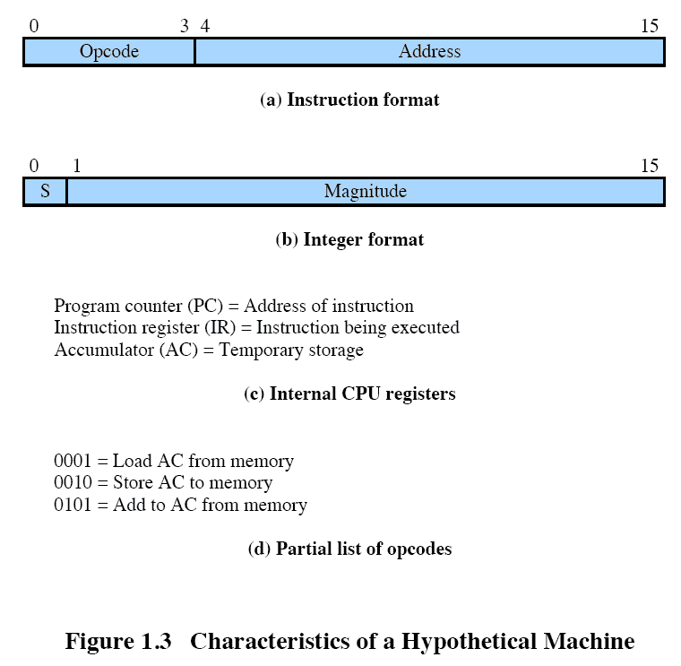
Notes:
Consider a simple example using a hypothetical processor that includes the characteristics listed in Figure 1.3 . The processor contains a single data register, called the accumulator (AC). Both instructions and data are 16 bits long, and memory is organized as a sequence of 16-bit words. The instruction format provides 4 bits for the opcode, allowing as many as 2⁴ =16 different opcodes (represented by a single hexadecimal digit). The opcode defines the operation the processor is to perform. With the remaining 12 bits of the instruction format, up to 2¹² =4,096 (4K) words of memory (denoted by three hexadecimal digits) can be directly addressed.

Slide 24
Notes:
Figure 1.4 illustrates a partial program execution, showing the relevant portions of memory and processor registers. The program fragment shown adds the contents of the memory word at address 940 to the contents of the memory word at address 941 and stores the result in the latter location. Three instructions, which can be described as three fetch and three execute stages, are required:
The PC contains 300, the address of the first instruction. This instruction (the value 1940 in hexadecimal) is loaded into the IR and the PC is incremented. Note that this process involves the use of a memory address register (MAR) and a memory buffer register (MBR). For simplicity, these intermediate registers are not shown.
2. The first 4 bits (first hexadecimal digit) in the IR indicate that the AC is to be loaded from memory. The remaining 12 bits (three hexadecimal digits) specify the address, which is 940.
3. The next instruction (5941) is fetched from location 301 and the PC is incremented.
4. The old contents of the AC and the contents of location 941 are added and the result is stored in the AC.
5. The next instruction (2941) is fetched from location 302 and the PC is incremented.
6. The contents of the AC are stored in location 941.
In this example, three instruction cycles, each consisting of a fetch stage and
an execute stage, are needed to add the contents of location 940 to the contents
of 941. With a more complex set of instructions, fewer instruction cycles would be
needed. Most modern processors include instructions that contain more than one
address. Thus the execution stage for a particular instruction may involve more than
one reference to memory. Also, instead of memory references, an instruction may
specify an I/O operation.

Slide 25
Interrupts
Mechanism by which other modules may interrupt the normal sequencing of the processor
Provided to improve processor utilization
Most I/O devices are slower than the processor
Processor must pause to wait for device
Wasteful use of the processor
Notes:
Virtually all computers provide a mechanism by which other modules (I/O, memory) may interrupt the normal sequencing of the processor.
Interrupts are provided primarily as a way to improve processor utilization. For example, most I/O devices are much slower than the processor. Suppose that the processor is transferring data to a printer using the instruction cycle scheme of Figure 1.2 . After each write operation, the processor must pause and remain idle until the printer catches up. The length of this pause may be on the order of many thousands or even millions of instruction cycles. Clearly, this is a very wasteful use of the processor.

